Slide 1

Leave Management System
This presentation introduces a comprehensive Leave Management System designed to streamline and automate employee leave processes.
By Haileab Shimels

Slide 2
Introduction to the Leave Management System
The Leave Management System utilizes a robust and scalable architecture, featuring a user-friendly web interface built with modern front-end technologies. It leverages a powerful back-end infrastructure powered by a robust database to securely store and manage employee leave information.
The system is deployed on a secure cloud platform, ensuring high availability and accessibility for users. Integration with existing HR systems and other business applications is also supported, enabling seamless data exchange and process automation.

Slide 3
System Architecture
Frontend
Backend
Database
React.js with TypeScript
Node.js with Express.js
MongoDB

Slide 4
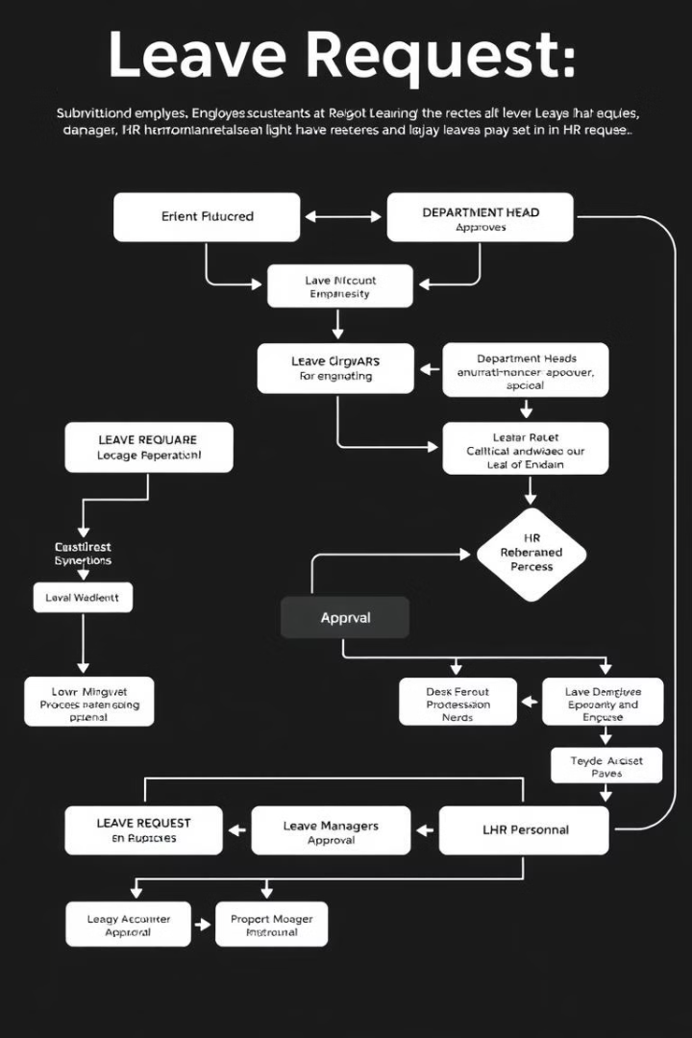
User Roles and Functionalities
1
Applicant
Submit, view, cancel, and modify leave requests.
2
Department Head
Approve or deny requests, view statistics.
3
Process Manager
Finalize approved requests with digital signatures.
4
HR Personnel
Generate reports, view system-wide statistics.

Slide 5

Technologies Used
Frontend: React.js with TypeScript
Backend: Node.js with Express.js
Database: MongoDB
Authentication: JSON Web Tokens (JWT)
UI Components: Custom components using Tailwind CSS, shadcn UI
Charts and Graphs: Recharts library
Icons: lucide icons
React signature canva​
React CSV

Slide 6

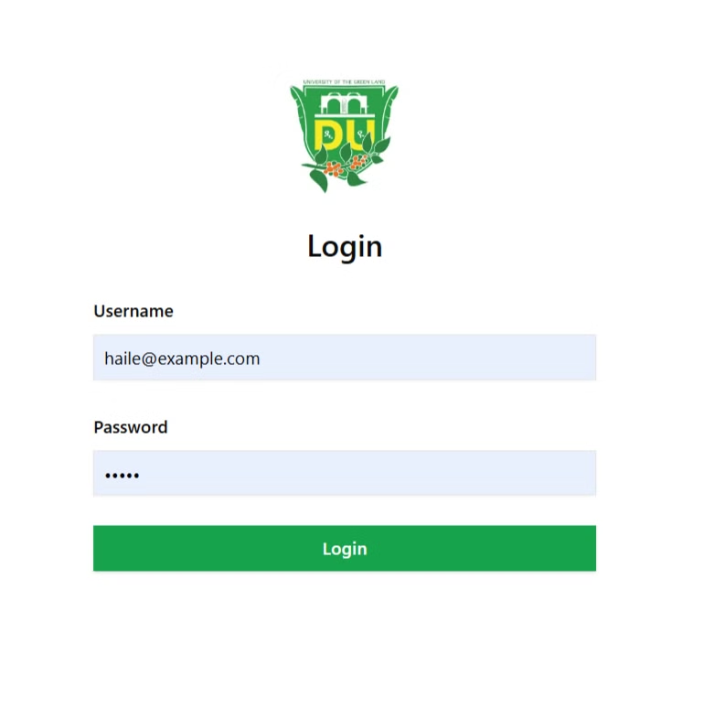
Login Page
The login page is the entry point for all users, with email and password authentication, role-based redirection, and error handling for invalid credentials.

Slide 7

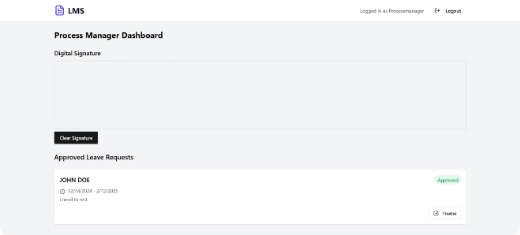
Applicant Dashboard
Leave Request Form
Calendar View
Leave Request List
Submit new leave requests.
Visualize leave days.
Track status of requests.

Slide 8

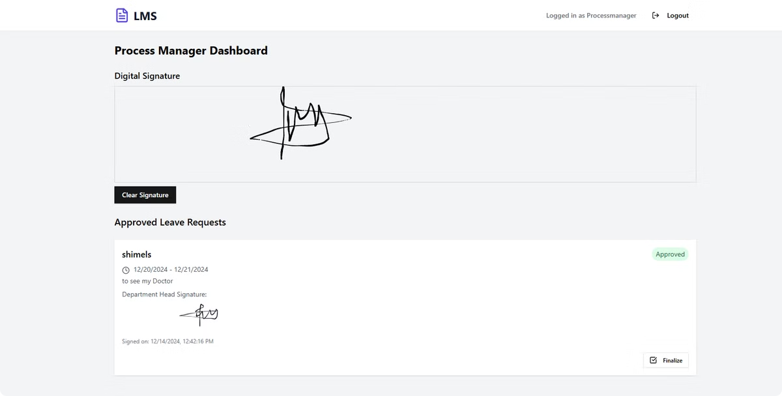
Process Manager Dashboard
The process manager dashboard is designed to finalize approved leave requests. This dashboard allows the process manager to review and approve leave requests that have been approved by department heads.
The dashboard provides a list of pending requests, a digital signature pad for final approval, and an overview of processed requests. This ensures that leave requests are handled efficiently and promptly.

Slide 9

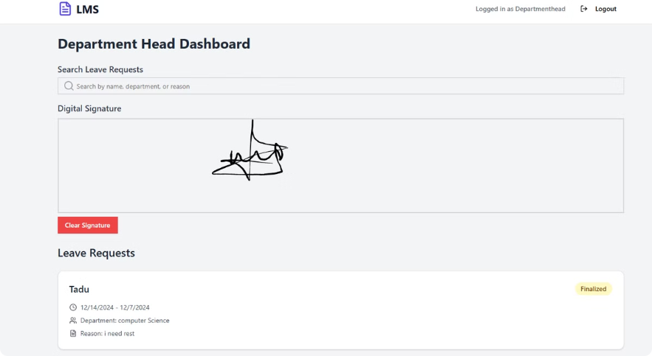
Department Head Dashboard
Pending Requests
Statistics Overview
Digital Signatures
Review and approve or deny requests.
Gain insights into department leave patterns.
Approve requests with digital signatures.

Slide 10

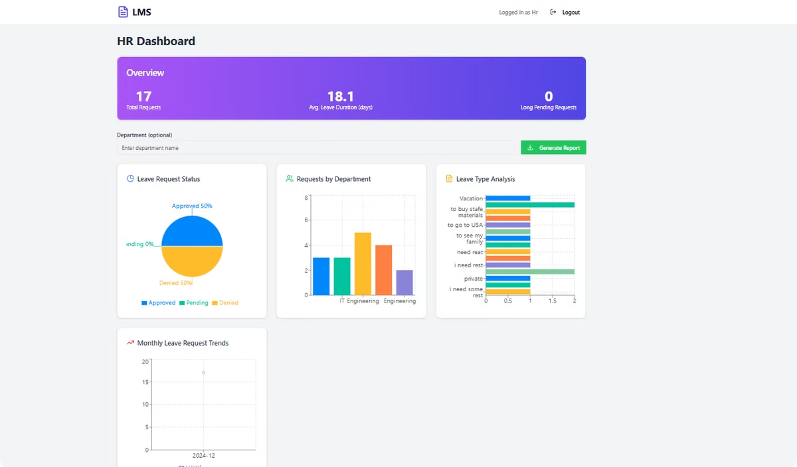
HR Dashboard
The HR dashboard provides a comprehensive view of the organization's leave management, enabling analysis of leave patterns and trends across departments.

Slide 11
Technical Implementation Highlights
React Hooks manage state and side effects, improving component reusability.
Custom UI components, built with Tailwind CSS, provide a consistent and visually appealing user experience.
Server-side data validation and error handling ensure data integrity and prevent unexpected errors.
JWT-based authentication secures API access, protecting sensitive data.
MongoDB aggregation pipelines enable complex data queries, providing insights into leave patterns.

Slide 12
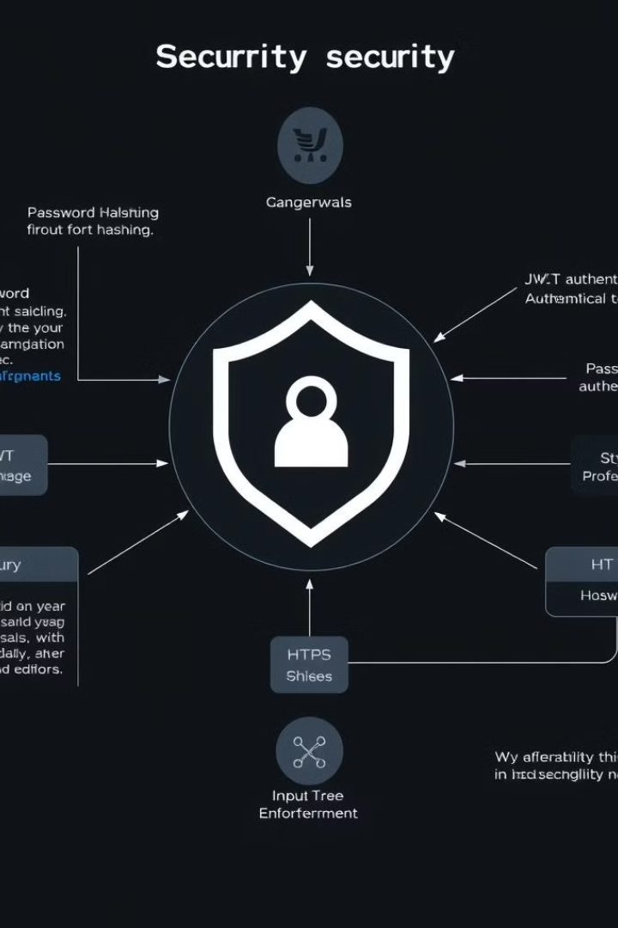
Security Measures
- Secure password hashing using bcrypt
- JWT for stateless authentication
- Role-based access control (RBAC) for API endpoints
- Input validation and sanitization to prevent injection attacks
- HTTPS enforcement for all communications

Slide 13
Conclusion
This Leave Management System streamlines leave processes, minimizes paperwork, and offers valuable data-driven insights into leave trends, benefiting organizations of all sizes with its user-friendly design and reliable backend.

